Slide 1
SECURE DATA HIDING IN IMAGES USING STEGANOGRAPHY
CAPSTONE PROJECT
Presented By : Satharla Punith Kumar
Student Name : Satharla Punith Kumar
College Name & Department : Anantha Lakshmi Institute Of Technology And Sciences, Computer Science And Engineering

Slide 2
OUTLINE
Problem Statement
Technology used
Wow factor
End users
Result
Conclusion
Git-hub Link
Future scope

Slide 3
Problem Statement
Objective:
To design and implement an advanced image steganography algorithm that improves payload capacity, maintains image quality, and enhances resistance to detection. The project will explore both spatial and frequency domain techniques, such as LSB (Least Significant Bit) and DCT (Discrete Cosine Transform), to achieve optimal results.
Expected Outcome:
By the end of the internship, the goal is to develop a robust steganography tool that can be used for secure data transmission, ensuring high levels of confidentiality and integrity while minimizing the risk of detection.

Slide 4
Technology used
Python:
Pillow: A Python Imaging Library (PIL) fork used to manipulate images and embed hidden data in image files.
OpenCV: A popular computer vision library that can be used for image processing tasks, including steganography.
Stegano : A Python library specifically designed for image steganography. It supports hiding text in images using LSB (Least Significant Bit) encoding.
Cryptosteganography : A Python library that combines cryptography and steganography to provide a secure way of embedding hidden messages inside images.
PyCrypto : For encrypting the data before embedding it in the image

Slide 5
Wow factors
Combines encryption and steganography for double-layered security.
Preserves image quality while embedding hidden data.
Supports embedding multiple files in a single image.
Features resistance to common steganalysis detection tools.
Provides a user-friendly, cross-platform interface for seamless data transfer.

Slide 6
End users
The end users of an image steganography project can include:
Cybersecurity Professionals: To securely transmit sensitive information without detection.
Government Agencies: For secure communication in intelligence and defense.
Privacy-Conscious Individuals: Users who want to protect personal data and maintain privacy.
Businesses: To securely exchange proprietary data and confidential documents.
Journalists and Activists: For secure communication in regions with restricted information freedom.

Slide 7
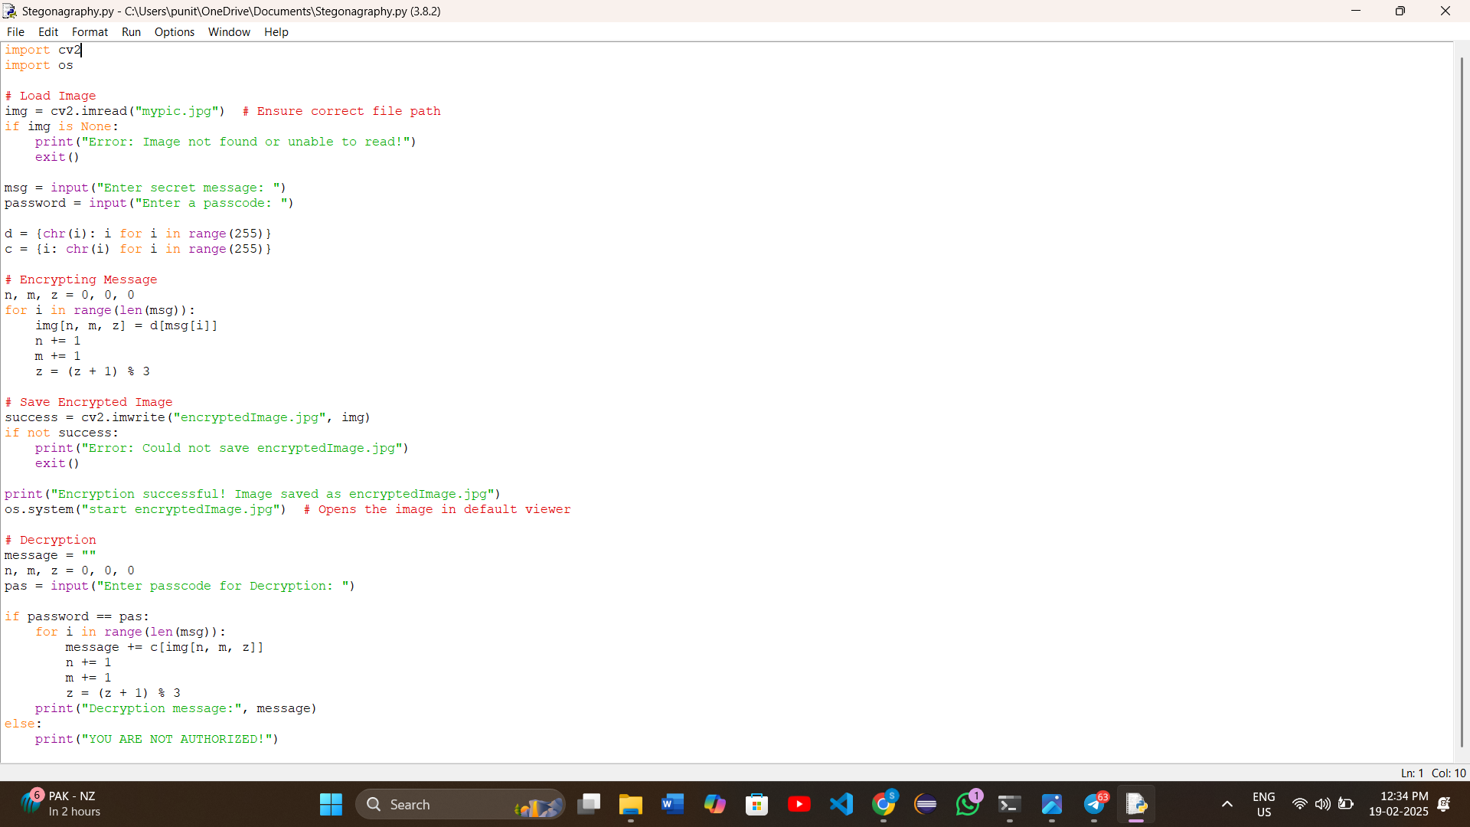
Result IMAGES

Slide 8
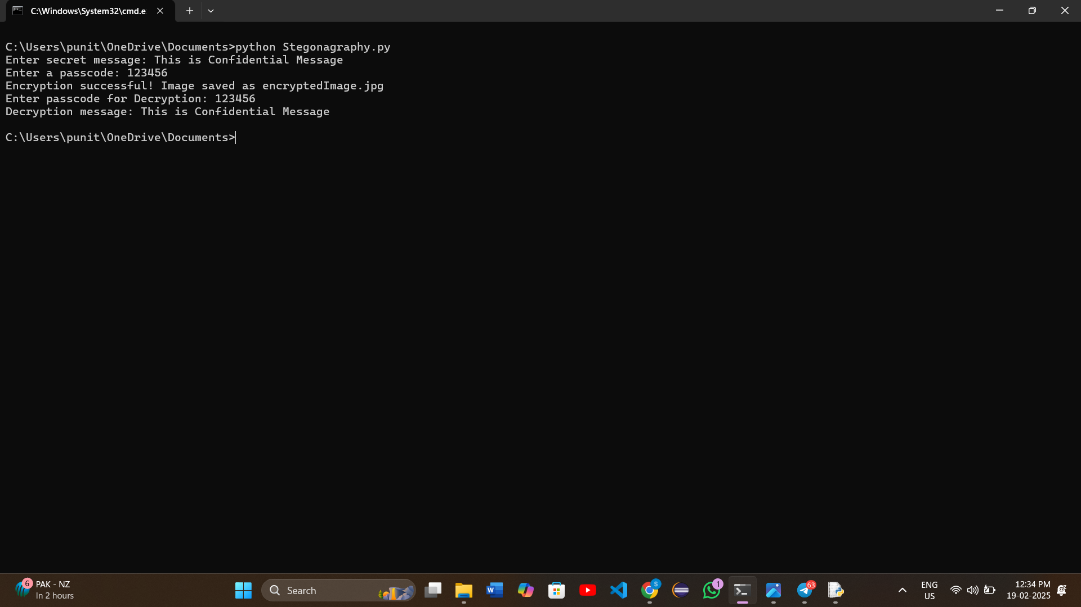
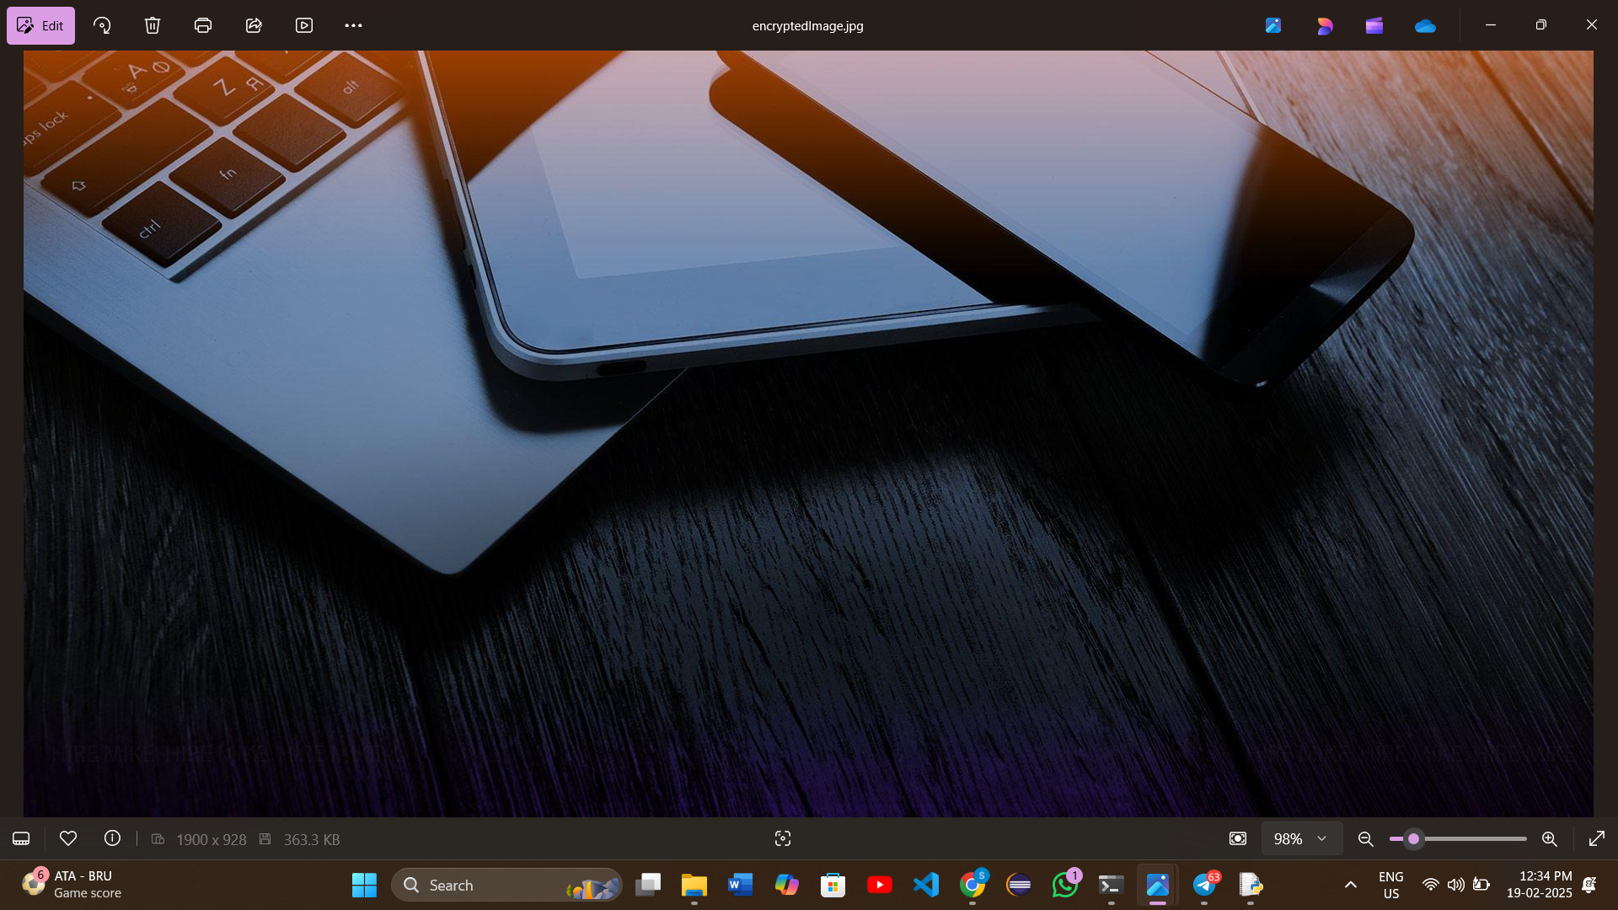

Slide 9
Conclusion
In conclusion, this image steganography project effectively addresses the problem of secure data
transmission by embedding sensitive information within image files, ensuring that the data remains concealed
from unauthorized detection. By combining cryptographic techniques with steganography, it provides a double
layer of security, safeguarding the confidentiality and integrity of the data. The project also preserves the quality
of the image, making it undetectable to the human eye. With its potential for future advancements, such as AI
detection resistance and multi-modal support, this project offers a promising solution for secure communication
across various sectors.

Slide 10
GitHub Link
https://github.com/SatharlaPunithKumar/edunet-project-2025.git

Slide 11
Future scope(optional)
The future scope of the image steganography project can include:
Integration with Blockchain: Using blockchain for verifying and tracking the integrity of hidden data to
ensure authenticity and prevent tampering.
AI-based Detection Avoidance: Developing AI algorithms to dynamically adjust encoding methods, making
it harder for advanced detection tools to identify hidden data.
Mobile App Development: Creating a mobile application for on-the-go secure communication
and data sharing via steganography.
Multi-modal Steganography: Expanding the project to hide data in other media types,
such as audio and video, alongside images.
Cloud-based Steganography: Enabling users to securely upload and share steganographic content via cloud
platforms with enhanced encryption methods.

Slide 12
THANK YOU

